Slide 1
Data Structures
and
Algorithms
- Preliminaries
CSCI 237 –
Fall 2019

Slide 2

Mathematics Preliminaries:
Mathematical preliminaries:
Differentiation:
(1) f($x$) = $x^{1/3}$
(2) f($x$) = $e^{x}$
(3) f($x$) = ${bxe}^{ax}$
(4) f($x$) = $x^{−1/2}$

Slide 3
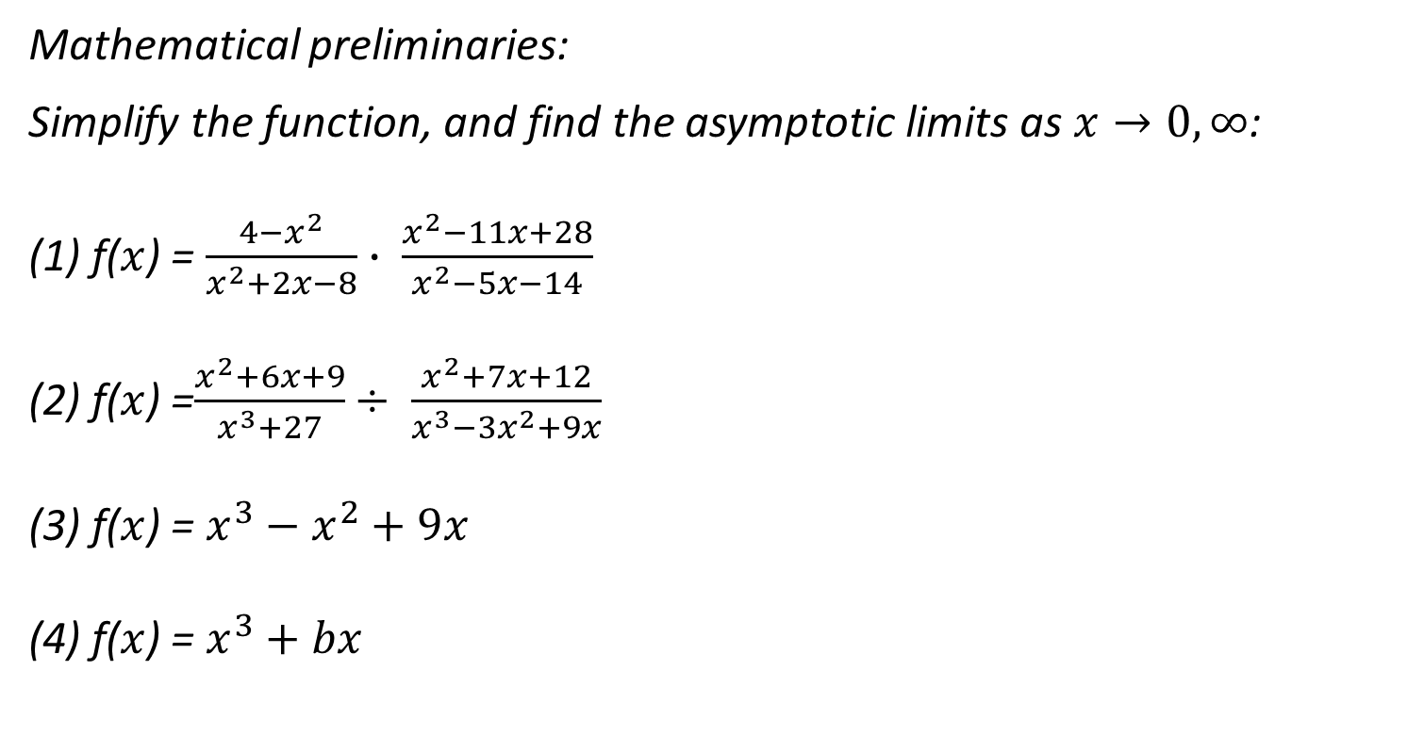
Mathematics Preliminaries:
Mathematical preliminaries:
Simplify the function, and find the asymptotic limits as $x→0, ∞$:
(1) f($x$) = $\frac{4−x^{2}}{x^{2}+2x−8}∙ \frac{x^{2}−11x+28}{x^{2}−5x−14}$
(2) f($x$) =$\frac{x^{2}+6x+9}{x^{3}+27}÷ \frac{x^{2}+7x+12}{x^{3}−3x^{2}+9x}$
(3) f($x$) = $x^{3}−x^{2}+9x$
(4) f($x$) = $x^{3}+bx$
0 -3

Slide 4
Preliminaries:
Pseudocode:
What is -
Pseudocode is an informal tool that you can use to plan out your algorithms.
As you begin to write more complex code, it can be hard to keep an entire program in your head before coding it.
Think of pseudocode as a step-by-step verbal outline of your code that you can later transcribe into a programming language.
It is a combination of human language and programming language: it mimics the syntax of actual computer code, but it is more concerned with readability than with technical specificity.
0 - 4

Slide 5
Preliminaries:
Pseudocode:
Example:
Consider the problem of finding the value of the largest element in a list of n numbers. For simplicity, we assume that the list is implemented as an array. The following is pseudocode of a standard algorithm for solving the problem.
ALGORITHM MaxElement(A[0..n − 1]) //Determines the value of the largest element in a given array //Input: An array A[0..n − 1] of real numbers //Output: The value of the largest element in A maxval ←A[0] for i ←1 to n − 1 do if A[i]>maxval maxval←A[i] return maxval

Slide 6
Preliminaries:
Fundamental Data Structures:
Variables
Arrays
Matrices
Lists
ArrayLists

Slide 7
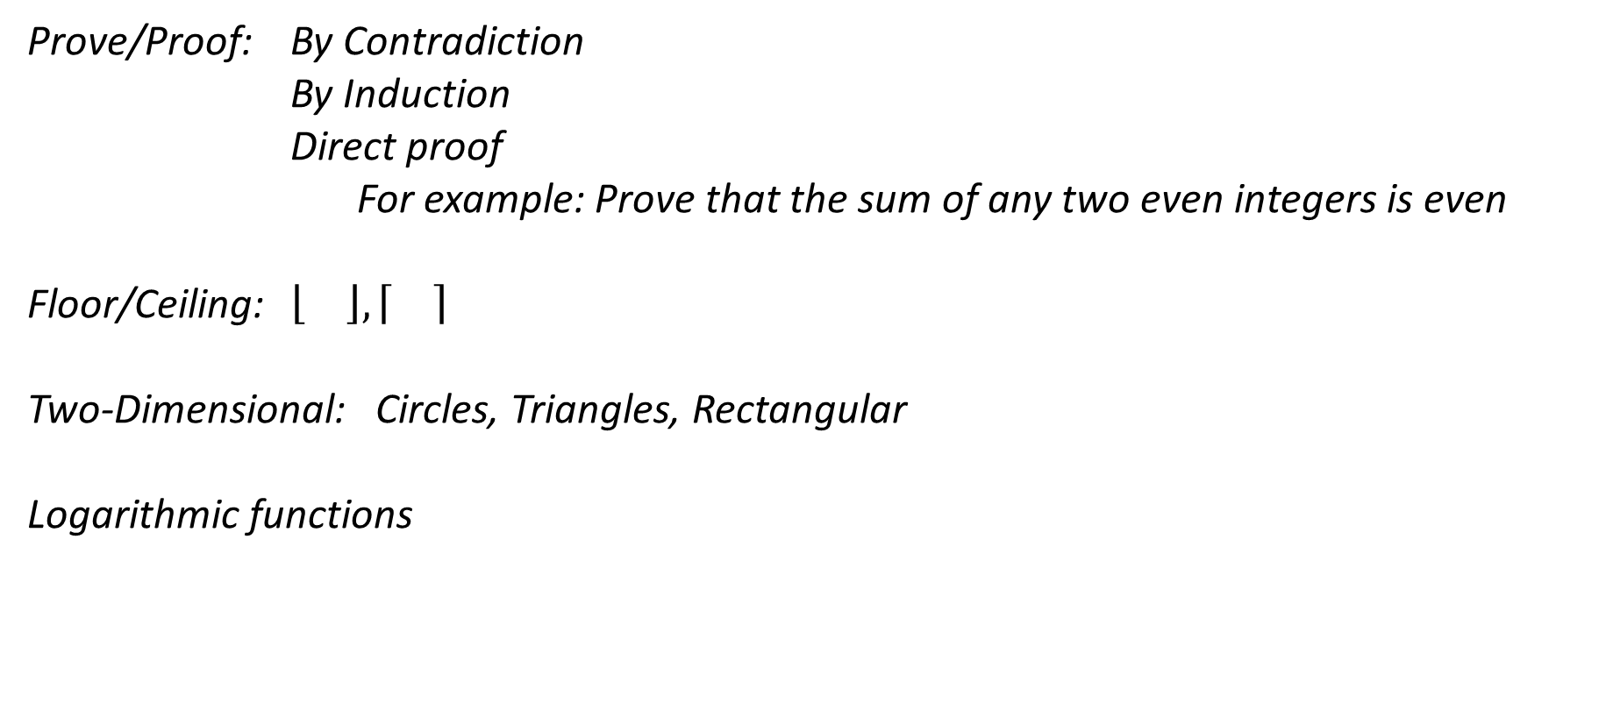
Preliminaries:
Prove/Proof: By Contradiction
By Induction
Direct proof
For example: Prove that the sum of any two even integers is even
Floor/Ceiling: $\left\lfloor \right\rfloor , \left\lceil \right\rceil$
Two-Dimensional: Circles, Triangles, Rectangular
Logarithmic functions

Slide 8
Preliminaries:
Sequences, Series, Probability:
Appendix A, page 475

